Slide 1
European Centre of Excellence for leading core
technology offerings to drive Digital Transformation in the global Insurance Industry

Slide 2
Inheritance
Inheritance: sharing of attributes and methods among classes
We can take a super class and create other classes based on this one, only more specialised for a specific task
Examples: employee Part time employee
Full time employee
student Computing student
Life Sciences student
vehicle Car
Van
We’re Here To Help You Start
We’re Here To Help You Start

Slide 3
Inheritance
These new sub classes will inherit attributes and methods from their super class
They can also have attributes and methods of their own
They can over-ride the attributes and methods of their super class
You can only inherit from a super class – it only works from classes above, not below
We’re Here To Help You Start
We’re Here To Help You Start

Slide 4
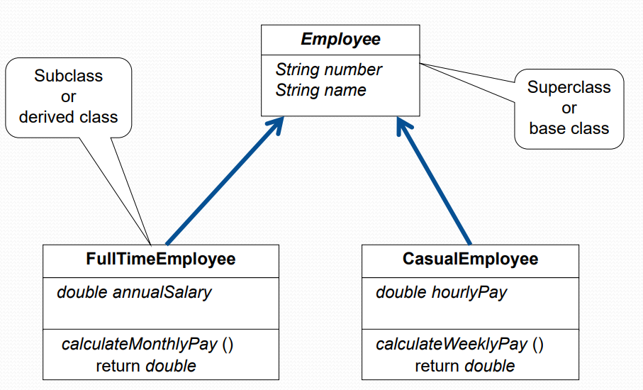
Example (Employees in a Company)
We’re Here To Help You Start
We’re Here To Help You Start

Slide 5
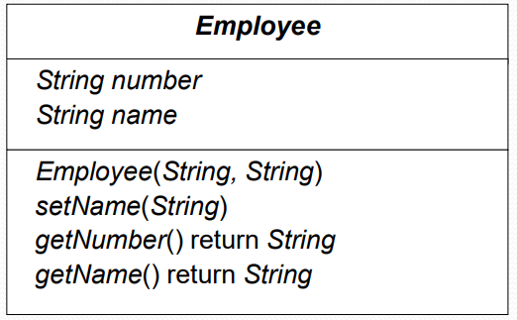
Design of the Employee class
We’re Here To Help You Start
We’re Here To Help You Start

Slide 6
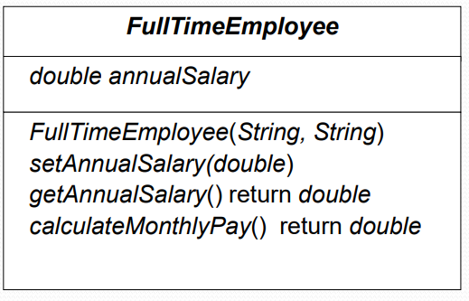
Design of the FullTimeEmployee class
We’re Here To Help You Start
We’re Here To Help You Start

Slide 7
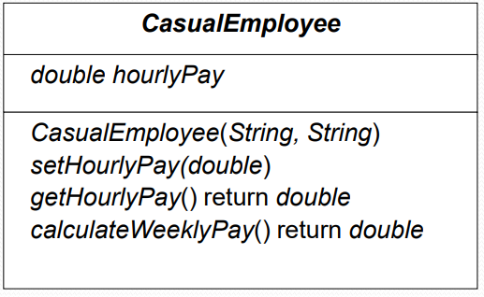
Design of the CasualEmployee class
We’re Here To Help You Start
We’re Here To Help You Start

Slide 8
Using the keyword extends
public class FullTimeEmployee extends Employee
Note the additional extends Employee in the class header
The word extends tells C# the FullTimeEmployee is a sub-class of the Employee class
This means that Employee is the super class
We’re Here To Help You Start
We’re Here To Help You Start

Slide 9

Visibility Modifiers
Problem
The attributes (number, name) have been declared as private in the super class (Employee) so none of the FullTimeEmployee class methods can directly access them
Possible Solutions
Declare the attributes as public X
Declare the attributes as protected ?
Leave the attributes as private, but plan in
advance how to code the methods that
provide access to these attributes
accessors/mutators
We’re Here To Help You Start
We’re Here To Help You Start

Slide 10
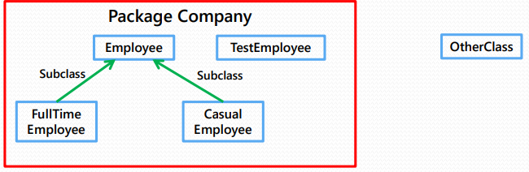
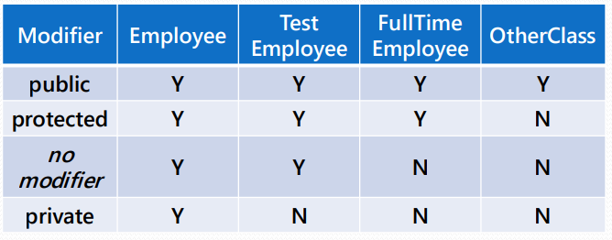
Visibility Modifiers
The following table shows where the members of the Employee class are visible for each of the access modifiers that can be applied to them
We’re Here To Help You Start
We’re Here To Help You Start

